Slide 1
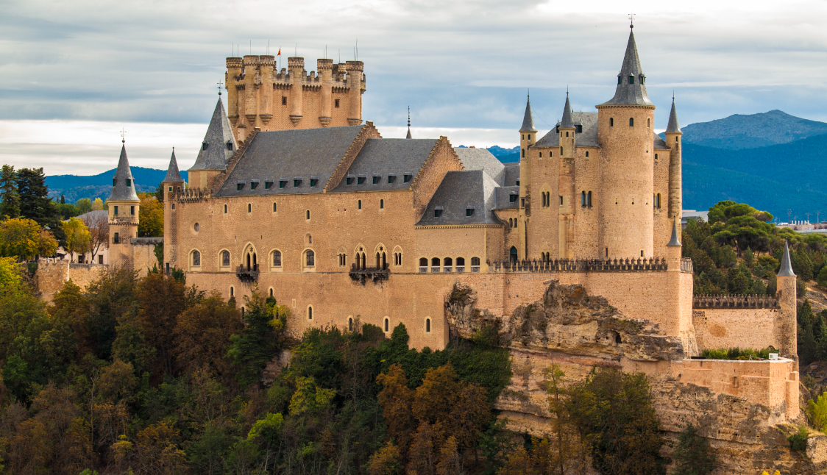
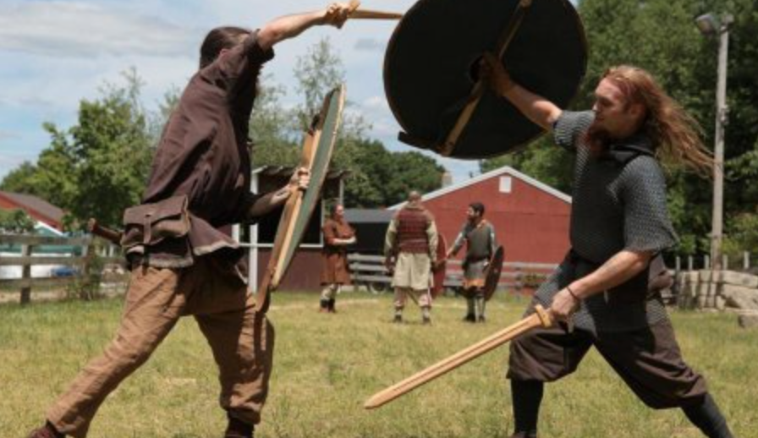
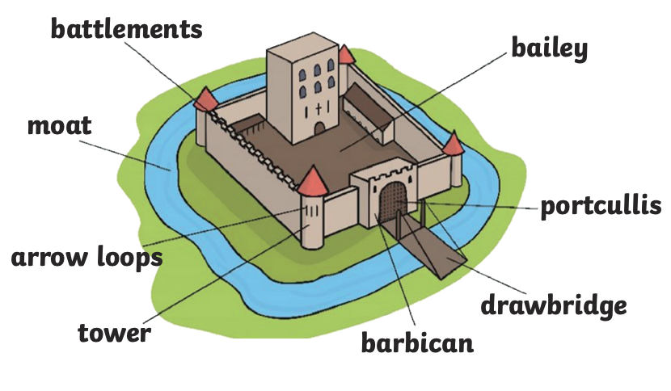
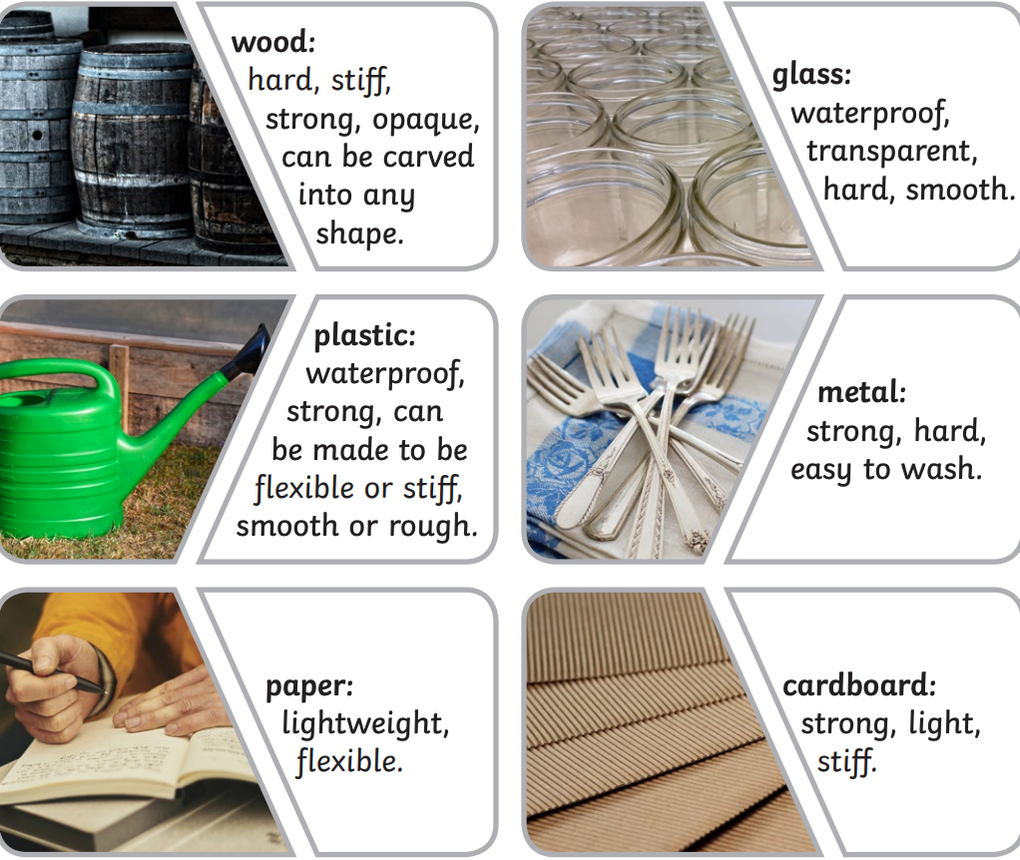
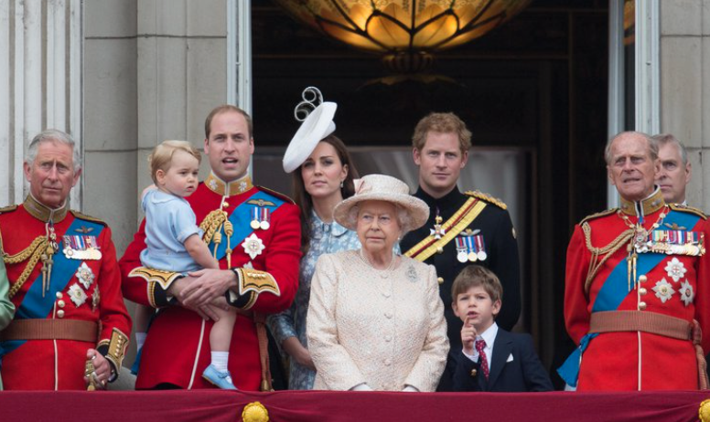
Castles and Dragons
Sticky Knowledge
What I should already know?
We live in the 21st Century. Our King is called King Charles III. He is in charge of the Monarchy.
The past is something that has already happened.
The present is now. The future is what happens next.
I need to eat 5 fruit/vegetables a day for a healthy diet.
Stone is a strong material. Paper is not as strong as stone.
A King lives in a castle, a type of home.
Key Vocabulary
Castle: A large, strong structure designed to protect people from attack.
Defend: To protect those living in the castle from attack or danger.
Weapon: To injure or hurt someone, when defending yourself.
Battle: A fight between two groups.
Attack: To hurt others to steal something important.
Medieval: Known as the The Middle Ages or The Dark Ages.
Invasion: To take over a place or country using weapons.
Monarch: A King or Queen. They are in charge of our Monarchy. They live in a palace.
Castles were built to protect people from invasion. A secure place to attack and fire weapons.
You can see through transparent materials (glass) but not opaque.

Slide 2
Assessment of previous knowledge?
Plans to secure facts
What comes next?
Look at the monarchy from past and present. Identify and analyse artifacts and photographs that show us if they are from the past and present. Create a timeline to understand the concept of time.
Use a cafe roleplay to understand what a good diet looks like and identify the key features, ie. the amount of fruit and vegetables compared to chocolate.
Compare and contrast different materials through a science experiment that will demonstrate what properties different materials have.
Identify the features of a castle and use the monarchy to decide who would live here.
Create a clear timeline of our Monarchs to identify and compare how times have changed in a variety of ways. Such as, our diet, protection and our rights.
Look intently at a variety of materials to describe their properties. Complete two fair tests. What material would be best for the 3 Little Pigs and why? What material would be best to stop the soldier becoming wet? Analyse our results and conclude if we predicted correctly.
Use a Florence Nightingale immersion day to compare an aspect of life between 2 different periods (1837 - modern day). Compare and consider the impact of medicine, social care and hospitals and how this has progressed over time.
Understanding the changes in Britain from the Stone Age to the Iron Age. Looking at the Vikings to compare the past and present.
Compare an aspect of life between 2 different time periods from the past. They may also then compare these to the modern day. They consider the impact of the developments on the people.
.
School Values
PSHE/Environmental/Citizenship/British Values links
Responsibility- Take responsibility to allow other children to live their rights whilst at school. Consider how we are treating everyone whilst we are at school. Understand there is no hierarchy when we are thinking about our rights.
Respect- Identify and understand the importance of our rights that we all have. Why are these so important? How can we demonstrate these rights every single day?
Look at how our rights have changed from the past. Why is this so important? Use our skills to compare from then to now.
How do the British Monarchy demonstrate our British Values?
Plans to develop skills
Observation: Use a variety of materials in a fair test to decide which material has the best properties for the given purpose.
Comparison: Compare how times have changed from the Medieval times to now. Analyse the past and present through diet, our rights, the use of castles, protection in a battle and how the poor and rich people lived.
Geographer skills: Locate and pinpoint castles on the map throughout the world using atlases. Identify the largest castle in the world, Malbork Castle in Poland.
Opportunities for problem solving
Use various materials to create an invention. Identify what materials will work best for the invention required, predict if your invention will be successful and discuss what other materials may be more suitable. Why?
Links?
PSHE – Looking at how people past and present were similar or different to us.

